Slide 1








FINTECH ETF Analysis
A selective entry into
financial digitization
ARKF • FINX • FDFF | Long-only thematic equity assessment
Xiaowen Chen (Xavier)
Parag Verma
Samuel Moshiashvili
Jared Mount
Theofilos Kelemis

Slide 2
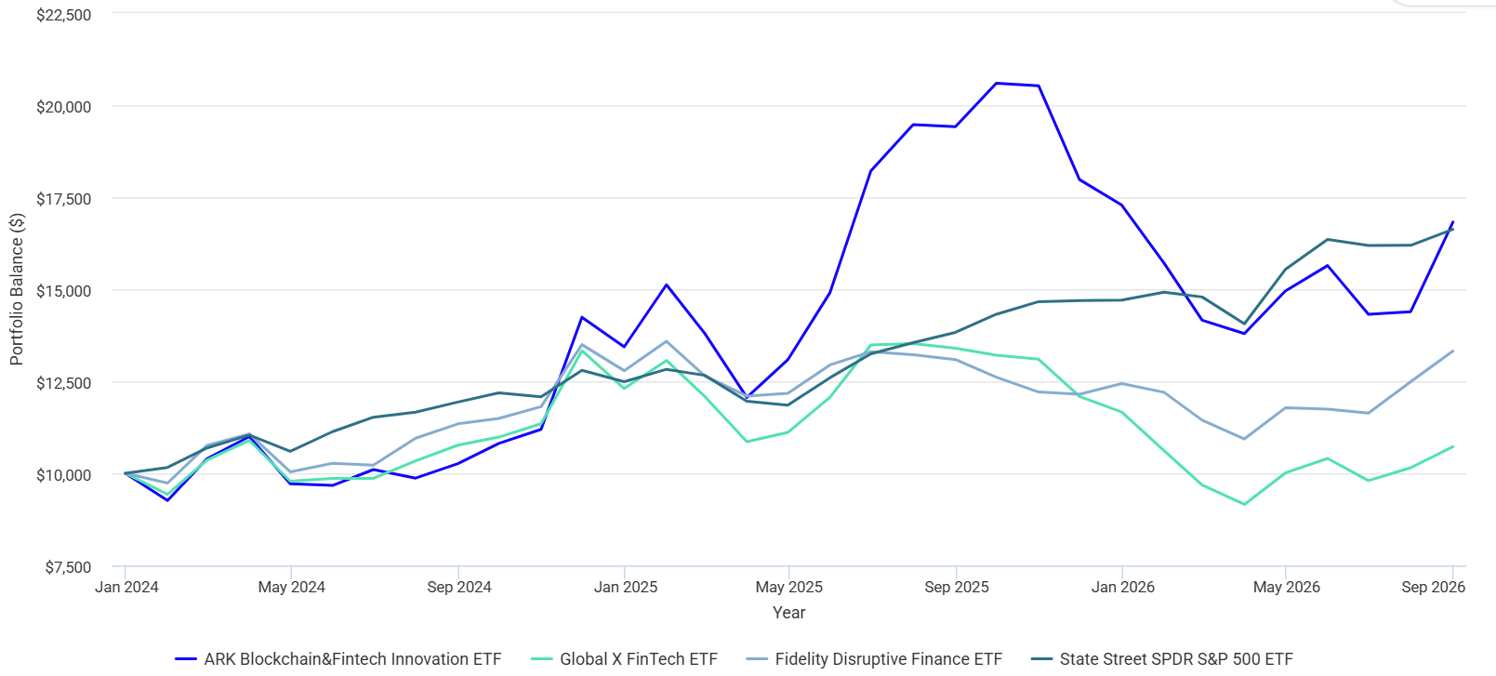
FINTECH | Performance
Performance (2024 Jan to 2026 Sep)
ARKF: +68%
SPY: +66%
FDFF: +33%
FINX: +7%
Sources: https://www.portfoliovisualizer.com/backtest-portfolio#analysisResults, Code: ARKF, FDFF, FINX, Benchmark: SPY, data fetched Sep 30, 2026

Slide 3
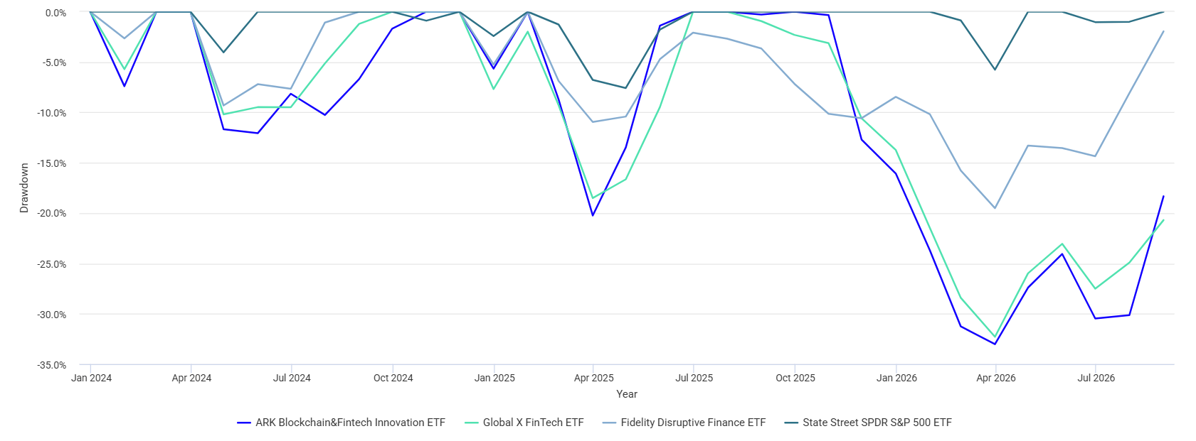
FINTECH | Performance
Drawdown (2024 Jan to 2026 Sep)
SPY: 0%
FDFF: -2%
ARKF: -18%
FINX: -21%
Sources: https://www.portfoliovisualizer.com/backtest-portfolio#analysisResults, Code: ARKF, FDFF, FINX, Benchmark: SPY, data fetched Sep 30, 2026

Slide 4
FINTECH | Performance drivers
Reasons behind drawdown
Pressure / offset | Issuer evidence
Macro risk aversion | 2025 tariff uncertainty and Q1 2026 geopolitical tensions raised inflation and growth concerns. [1]
Payments earnings pressure | Fiserv reset 2025 organic growth guidance to 3.5–4%. Fidelity cited slower growth and pricing concerns. [2, 3]
Crypto weakness | ARKF Q2 2026: Circle −2.22 pp, Coinbase −1.00 pp and Bitcoin ETF −0.85 pp of return contribution. [4]
Offsets within FDFF | DBS (+50%) was FDFF’s top contributor. Fidelity exited Adyen (−40%) and reduced payments exposure. [3]
Sources:
[1] ARK Investment Management, Q1 2026 CIO commentary.
[2] Fiserv, Q3 2025 results (Oct. 29, 2025).
[3] Fidelity, Disruptive ETFs PM Q&A (May 31, 2026), pp. 4–5.
[4] ARK, Q2 2026 Quarterly Report, p. 15.
Notes:
Purpose and placement
Insert this slide directly after the user-supplied performance/drawdown chart titled "Drag down (2024 Jan to 2026 Sep)". It supplies an evidence-based explanation of major pressures in the 2025–26 declines and recovery, rather than asserting a complete quantitative attribution for January 2024 through September 2026. The preceding chart is a drawdown chart: its endpoint values are distances below each portfolio's prior peak, not cumulative returns from January 2024. The underlying Portfolio Visualizer series was not supplied, so the chart's endpoint values are not independently recalculated here.
1. Macro pressure
ARK's Q1 2026 CIO commentary, dated April 16, 2026, discusses 2025 tariff escalation and policy uncertainty, then Q1 2026 geopolitical tensions and inflation/growth concerns. It also describes a broad repricing of software equities as investors reassessed AI disruption. These are issuer explanations of the market environment, not measured contributions to any one fund's drawdown.
Source: https://www.ark-funds.com/articles/etf/q1-2026-commentary-from-arks-cio
2. Payments earnings pressure
Fiserv's October 29, 2025 release reset its 2025 organic revenue growth outlook to 3.5–4% and adjusted EPS outlook to $8.50–$8.60. The slide cites the growth guidance as evidence of company-level earnings pressure in the payments industry, not as a computed FINX return contribution. Fidelity's supplied May 31, 2026 Q&A says its payment-processing overweight hurt relative performance amid slower growth and commoditization concerns.
Source: https://investors.fiserv.com/news-releases/news-release-details/fiserv-reports-third-quarter-2025-results
Source: user-supplied "FDFF fund maanger Q&A.pdf", Fidelity Disruptive ETFs, Portfolio Manager Q&A as of May 31, 2026, pp. 4–5.
3. Crypto detractors and the incomplete ARKF rebound
ARK's Q2 2026 Quarterly Report reports individual contributions to ARKF's quarterly performance: Circle Internet Group -2.22 percentage points, Coinbase -1.00 pp and ARK 21Shares Bitcoin ETF -0.85 pp. These are contributions to fund return, not stock returns or holding weights. They demonstrate a drag during the rebound, not a claim that ARKF's entire quarter was negative. The same report shows ARKF NAV total return of +3.77% in Q2 2026. Other holdings contributed positively.
Source: ARK Q2 2026 Quarterly Report, p. 15, "BIGGEST CONTRIBUTORS/DETRACTORS | Q2 2026": https://etfs.ark-funds.com/hubfs/2_Download_Files_For_ARK_Funds/Reports/ARK_ETF_Trust_Quarterly_Report.pdf?_hsmi=121587257
The report URL is rolling. The version reviewed is titled "Update as of June 30, 2026 / Q2 2026".
4. FDFF offsets
Fidelity's May 31, 2026 Q&A identifies Adyen, whose shares fell 40% over the preceding fiscal year, as FDFF's largest individual relative detractor. It says the fund exited Adyen after the softened 2026 outlook and reduced payment-processing exposure. It identifies DBS, whose shares rose 50%, as its top contributor. The +50% and -40% are individual stock returns for the 12 months ending May 31, 2026, not fund contributions. The evidence shows offsets and active changes, but does not quantify how much they explain the September drawdown endpoint.
Source: user-supplied "FDFF fund maanger Q&A.pdf", Fidelity Disruptive ETFs, Portfolio Manager Q&A as of May 31, 2026, pp. 4–5. Institution: Fidelity Investments, https://institutional.fidelity.com/
Analyst interpretation
The bottom-line statement is a qualitative inference from the issuer evidence. ARKF's crypto exposures, payment-sector weakness relevant to the FinTech universe, and FDFF's bank exposure/active changes help explain differing return paths. This is not a claim that current holdings reproduce historical exposures, and no formal multi-fund drawdown attribution is asserted.
Sources reviewed October 1, 2026.

Slide 5
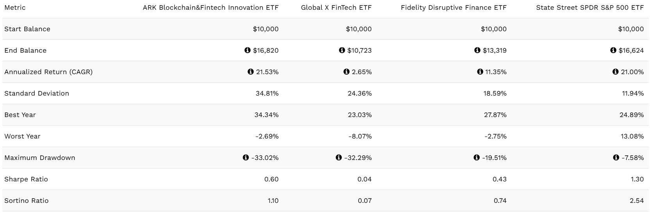
FINTECH | Performance
Performance (2024 Jan to 2026 Sep)
Why Fintech industry?
Sources: https://www.portfoliovisualizer.com/backtest-portfolio#analysisResults, Code: ARKF, FDFF, FINX, Benchmark: SPY, data fetched Sep 30, 2026
Notes:
Higher rates have mixed effects: adverse to duration-sensitive valuations and nonbank funding, potentially supportive of reserve interest or certain bank revenue. Credit risk and deposit costs still matter. FX, tariffs and geopolitical shocks can affect cross-border activity and global holdings.
SOURCES (accessed September 30, 2026 unless a supplied document):
https://www.federalreserve.gov/newsevents/pressreleases/monetary20260916a.htm
https://www.bls.gov/news.release/archives/cpi_09112026.htm
https://www.sec.gov/Archives/edgar/data/1403161/000140316126000103/q32026earningsrelease.htm
Figures are historical unless explicitly identified as analyst judgment. Holdings can change. Past performance does not predict future returns.

Slide 6
FINTECH MACRO
Tailwinds
THE INDUSTRY
+10%
Payments, digital banking, lending, wealth platforms and financial software monetize the shift to digital transactions.
Visa payments volume
Year over year, constant dollars
WHY INVEST NOW
Resilient payment activity and emerging stablecoin rules support selective exposure to scalable financial infrastructure.
+13%
Visa cross-border volume
Year over year, constant dollars
WHAT MUST BE UNDERWRITTEN
Adoption must translate into durable margins and cash flow. Competition, credit losses and higher rates can absorb the gains.
Sources: Visa FYQ3 2026 earnings release (quarter ended June 30); Federal Reserve, September 24, 2026; analyst assessment.
01

Slide 7
FINTECH MACRO | REGULATION
Policy clarity creates opportunity
and new compliance costs
Regulatory status as of September 30, 2026
Policy area | Verified status | Investment implication¹
U.S. stablecoins | GENIUS framework enacted; Fed implementation proposals issued September 24. | Clearer route to regulated issuance; reserve and capital rules constrain economics.
U.S. open banking | CFPB reconsidering data-rights rules, including access fees, privacy and security. | Data portability could improve competition; timing and commercial terms remain risks.
EU crypto assets | MiCA’s maximum transition for existing service providers ended July 1, 2026. | Authorization raises barriers to entry and compliance costs for cross-border platforms.
Watch: Treasury expects GENIUS licensing requirements to begin January 18, 2027.
¹Investment implications are analyst judgments; proposals are not final rules.
Sources: Federal Reserve (9/24/26); U.S. Treasury (GENIUS rulemaking); CFPB data-rights rulemaking; ESMA, MiCA Article 143.
02

Slide 8
FINTECH MACRO | CATALYSTS
The cycle rewards cash generation
and exposes funding dependence
Fed target range: 3.75–4.00% after a 25 bp increase on September 16
Catalyst to monitor | Upside pathway¹ | Downside pathway¹
Rates and inflation | Lower discount rates can support growth valuations. | August CPI: +3.4% year over year; renewed tightening raises funding costs.
Consumer and credit | Steady spending supports transaction revenue and operating leverage. | Weak borrowers, higher losses and tighter funding can hurt lenders and BNPL providers.
AI and payment rails | Automation can reduce fraud and servicing costs; new rails expand use cases. | Pricing pressure, cyber losses and disintermediation can offset volume growth.
Committee stance: invest in structural adoption, but require evidence of monetization.
¹Scenario analysis, not forecasts or assigned probabilities.
Sources: Federal Reserve FOMC statement (9/16/26); BLS August 2026 CPI release (9/11/26); Visa FYQ3 2026; analyst analysis.
03

Slide 9
PART 1: FINTECH EARNINGS
Fintech holdings beat less reliably than the S&P 500
% OF COMPANIES BEATING EPS ESTIMATES
• S&P 500: 86% beat in Q2 2026.
• Fintech top 5: 4 of 5 beat in Q2.
• Past 3 quarters: only 5 of 15 beat.
• Small sample; GAAP vs. adjusted mismatches possible.
Q2 looked like the index. The prior 3 quarters did not
Sources: FactSet Insight (Aug 7, 2026) | Perplexity Finance: earnings history
Notes:
Sample: Shopify, Block, PayPal, Robinhood, Coinbase (large fintech holdings across ARKF and FINX). Q2 2026: SHOP, XYZ, PYPL, HOOD beat EPS; COIN missed (4 of 5 = 80%). Over Q4 2025 to Q2 2026 (15 company-quarters), 5 beat: SHOP 1, XYZ 1, PYPL 1, HOOD 2, COIN 0 = 33%. S&P 500 Q2 2026: 86% beat (FactSet). Caveat: small sample, and vendor data may compare GAAP actuals with adjusted consensus in some quarters (e.g., Block Q1, Coinbase), which exaggerates misses.
Sources:
- FactSet Insight (Aug 7, 2026): https://insight.factset.com/sp-500-earnings-season-update-august-7-2026
- Perplexity Finance: earnings history: https://www.perplexity.ai/finance/PYPL/earnings

Slide 10
PART 1: FINTECH EARNINGS
When fintech beats, the margin is often bigger
Q2 2026 EPS SURPRISE (%)
• Shopify and PayPal: ~8%, near the S&P norm.
• Block +19%, Robinhood +44%.
• Coinbase missed: -$1.36 vs. +$0.15.
Typical S&P beat is ~7%. Robinhood and Block beat by far more
Sources: FactSet Insight (Aug 7, 2026) | Perplexity Finance: earnings history
Notes:
Q2 2026 EPS surprise = (actual - consensus) / consensus. SHOP $0.42 vs $0.39 (+7.7%); PYPL $1.38 vs $1.28 (+7.8%); XYZ $1.02 vs $0.86 (+18.6%); HOOD $0.62 vs $0.43 (+44.2%). Coinbase reported -$1.36 vs +$0.15 expected, so percent surprise is not meaningful and is excluded. S&P 500 5-year average aggregate surprise is 7.0% (FactSet). Low EPS bases make percentage beats look large.
Sources:
- FactSet Insight (Aug 7, 2026): https://insight.factset.com/sp-500-earnings-season-update-august-7-2026
- Perplexity Finance: earnings history: https://www.perplexity.ai/finance/PYPL/earnings

Slide 11
PART 1: FINTECH EARNINGS
The expectations game: a beat is already priced in
1-DAY STOCK MOVE AFTER Q2 2026 EARNINGS (%)
• All but Coinbase beat EPS.
• Block and Robinhood beat but fell.
• Guidance and flows set the move.
Block and Robinhood beat EPS and still fell
Sources: Perplexity Finance: earnings history | FactSet Insight (Aug 7, 2026)
Notes:
Class concept: companies and analysts converge on beatable estimates, so the market reaction depends on guidance and what was priced in. Q2 2026 one-day moves: Shopify +17.0% (beat), PayPal +4.0% (beat), Block -6.2% (beat), Robinhood -3.6% (beat), Coinbase -10.6% (miss). FactSet shows 76% (10-yr) to 78% (5-yr) of S&P companies beat on average, so a beat alone is not news.
Sources:
- Perplexity Finance: earnings history: https://www.perplexity.ai/finance/PYPL/earnings
- FactSet Insight (Aug 7, 2026): https://insight.factset.com/sp-500-earnings-season-update-august-7-2026

Slide 12
PART 1: FINTECH EARNINGS
Next catalysts: Q3 earnings land Oct 27 to Nov 4
Company | Report date | Q3 EPS est. | Avg 1-day move
PayPal (PYPL) | Oct 27 | $1.32 | 9.0%
Coinbase (COIN) | Oct 29 | -$0.24 | 9.0%
Shopify (SHOP) | Nov 3 | $0.44 | 11.6%
Block (XYZ) | Nov 3 | $1.02 | 9.4%
Robinhood (HOOD) | Nov 4 | $0.53 | 9.1%
Typical fintech earnings move is 9-12% in one day
Sources: Perplexity Finance: earnings history | Perplexity Finance: consensus estimates
Notes:
Upcoming dates and consensus Q3 2026 EPS from Perplexity Finance: PayPal Oct 27 ($1.32), Coinbase Oct 29 (-$0.22), Shopify Nov 3 ($0.44), Block Nov 3 ($1.02), Robinhood Nov 4 ($0.53). Average one-day post-earnings move is the historical average (Shopify 11.6%, Block 9.4%, PayPal 9.0%, Robinhood 9.1%, Coinbase 9.0%).
Sources:
- Perplexity Finance: earnings history: https://www.perplexity.ai/finance/PYPL/earnings
- Perplexity Finance: consensus estimates: https://www.perplexity.ai/finance/PYPL/analysis

Slide 13
PART 1: FINTECH EARNINGS
Pro forma = adjusted = Street = non-GAAP
Company | Reported EPS | Consensus | Quarter
Block (XYZ) | -$0.52 | $0.68 | Q1 2026
Coinbase (COIN) | -$1.36 | $0.15 | Q2 2026
Shopify (SHOP) | -$0.45 | $0.32 | Q1 2026
Block (XYZ) | $1.02 | $0.86 | Q2 2026
Block's FY2026 consensus EPS is $4.06, but consensus net income is just $1.0B. Check which basis a number uses.
Fintech GAAP and Street EPS can diverge by a lot
Sources: SEC: Non-GAAP C&DIs | Perplexity Finance: earnings history | Perplexity Finance: consensus estimates
Notes:
Terms are interchangeable: Street EPS is company-adjusted. SEC rules require reconciliation to GAAP and equal prominence; public companies must follow GAAP. Vendor data: Block Q1 2026 -$0.52 vs $0.68 consensus; Coinbase Q2 2026 -$1.36 vs $0.15; Shopify Q1 2026 -$0.45 vs $0.32. The gaps are consistent with GAAP results compared against adjusted consensus (verify in each release). Block FY2026 consensus: EPS $4.06 but net income $1.0B. The lecture claim that non-GAAP use is higher now than in 1996 is not backed by a statistic I found.
Sources:
- SEC: Non-GAAP C&DIs: https://www.sec.gov/rules-regulations/staff-guidance/corporation-finance-interpretations/non-gaap-financial-measures
- Perplexity Finance: earnings history: https://www.perplexity.ai/finance/PYPL/earnings
- Perplexity Finance: consensus estimates: https://www.perplexity.ai/finance/PYPL/analysis

Slide 14
PART 1: FINTECH EARNINGS
Accounting lever: capitalized software lives
ANNUAL AMORTIZATION ON $100M OF SOFTWARE ($M)
• Longer life: +$13.3M pre-tax earnings per year.
• No change in cash flow.
• Class example: 4-year to 5-year schedule.
• Illustrative example.
Same cash, higher EPS. Check footnotes for changes
Sources: SEC Financial Reporting Manual | SEC: Non-GAAP C&DIs
Notes:
Illustrative: $100M of capitalized software amortized over 3 years expenses $33.3M a year; stretching to 5 years expenses $20M, adding $13.3M of pre-tax earnings per year with no change in cash. The class example was a 4-year to 5-year change ($25M to $20M). Not a specific company; look for useful-life changes in the footnotes.
Sources:
- SEC Financial Reporting Manual: https://www.sec.gov/about/divisions-offices/division-corporation-finance/financial-reporting-manual/frm-topic-8
- SEC: Non-GAAP C&DIs: https://www.sec.gov/rules-regulations/staff-guidance/corporation-finance-interpretations/non-gaap-financial-measures

Slide 15
PART 1: FINTECH VALUATION
Steady earnings vs. swings: PayPal, Robinhood, Block
QUARTERLY EPS ($)
• PayPal: steadiest EPS, lowest P/E.
• Robinhood: higher growth, 51.7x.
• Smoothing needs reserves; the 'jar' can run out.
Smooth EPS helps, but growth sets the multiple
Sources: Perplexity Finance: earnings history | Perplexity Finance: consensus estimates
Notes:
Quarterly EPS from the vendor: PayPal $1.23, $1.21, $1.38 (steady); Robinhood $0.66, $0.38, $0.62; Block $0.65, -$0.52, $1.02 (swingy, partly GAAP vs adjusted). Forward P/E on FY2026 consensus: PayPal 9.8x, Block 18.0x, Robinhood 51.7x. Growth overrides the smoothness premium here. Cookie-jar reserves can fill a weak quarter until the jar is empty.
Sources:
- Perplexity Finance: earnings history: https://www.perplexity.ai/finance/PYPL/earnings
- Perplexity Finance: consensus estimates: https://www.perplexity.ai/finance/PYPL/analysis

Slide 16
PART 1: FINTECH EARNINGS
Revenue beats are small. EPS beats are big
Q2 2026 SURPRISE VS. CONSENSUS (%)
• Revenue beats: 1.7% to 5.5%.
• EPS beats: 7.7% to 44.2%.
• Sales need customers; EPS has more levers.
Earnings amplify small sales beats, and have more levers
Sources: Perplexity Finance: earnings history | SEC: Non-GAAP C&DIs
Notes:
Q2 2026 revenue vs EPS surprise: Shopify +5.5% vs +7.7%; PayPal +2.5% vs +7.8%; Block +2.2% vs +18.6%; Robinhood +1.7% vs +44.2%. Lecture point: revenue manipulation is limited (discounts, early shipments; a truck leaving the warehouse can count as a sale), while earnings have many more discretionary levers.
Sources:
- Perplexity Finance: earnings history: https://www.perplexity.ai/finance/PYPL/earnings
- SEC: Non-GAAP C&DIs: https://www.sec.gov/rules-regulations/staff-guidance/corporation-finance-interpretations/non-gaap-financial-measures

Slide 17
PART 1: FINTECH VALUATION
Forward P/E: PayPal is cheap, Robinhood is not
FORWARD P/E (PRICE / CONSENSUS EPS)
• Higher EPS growth lowers forward P/E.
• Coinbase: FY2026 EPS negative; FY2027 69x.
• S&P 500 benchmark: 19.2x.
S&P 500 forward P/E is 19.2. Fintech spans 10x to 69x
Sources: Perplexity Finance: consensus estimates | FactSet Earnings Insight
Notes:
Forward P/E = price (Oct 1, 2026) / consensus EPS. XYZ $72.86: 18.0x FY2026, 13.9x FY2027. PYPL $53.00: 9.8x, 9.2x. HOOD $111.88: 51.7x, 38.2x. COIN $187.96: FY2026 EPS negative (-$2.88), FY2027 69.3x. S&P 500 forward P/E 19.2 (FactSet, Sep 25). Investors buy on forward multiples: when EPS is expected to grow, forward P/E is lower than trailing. Shopify consensus not retrieved. Fund-level P/Es (FINX 16.08x, FDFF 23.14x) appear on the valuation slide later.
Sources:
- Perplexity Finance: consensus estimates: https://www.perplexity.ai/finance/PYPL/analysis
- FactSet Earnings Insight: https://www.factset.com/earningsinsight

Slide 18
PART 1: FORECASTING
Forecast method: headwinds, tailwinds, then a range
Headwinds
Tailwinds
Range
Fed hikes, crypto swings, open-banking limbo
Stablecoin rules, tokenization, buybacks, EPS growth
Bear / base / bull ETF price
Case | EPS | P/E | Price
Bear | Lower | Lower | Low end
Base | Consensus | Current | Middle
Bull | Higher | Higher | High end
Price = EPS x P/E. Give a range, not a point
Sources: Federal Reserve FOMC statement | FactSet Earnings Insight
Notes:
Lecture method applied to fintech ETFs. Headwinds: Fed hiked to 3.75-4.00% on Sep 16 with another hike expected; crypto weakness; open-banking rules in limbo. Tailwinds: SEC tokenization exemption, GENIUS Act clarity, strong earnings revisions, buybacks resuming. The range of outcomes appears later in the deck.
Sources:
- Federal Reserve FOMC statement: https://www.federalreserve.gov/newsevents/pressreleases/monetary20260916a.htm
- FactSet Earnings Insight: https://www.factset.com/earningsinsight

Slide 19
PART 1: MARKET TIMING
September was weak for fintech ETFs as buybacks paused
S&P 500 WEIGHT IN BLACKOUT (%)
SEP 2026 CHANGE (%)
Blackouts end mid-Oct to Nov. Q4 often rebounds
Sources: Citadel's Rubner via Futunn | Seeking Alpha (Sep 23) | Perplexity Finance data
Notes:
Citadel's Scott Rubner: about 10% of S&P 500 weight in a pre-earnings buyback blackout on Sep 18, 61% by Sep 30; most resume after earnings (Nov 1). Midterm-year Q4 averages +5.6% from Sep 30 vs +2.9% for all years. ETF September change uses weekly closes Aug 28 to Sep 30, 2026: ARKF -1.2%, FINX -10.5%, FDFF -10.0%. Blackouts are one factor among several (rate hike, quarter-end rebalancing).
Sources:
- Citadel's Rubner via Futunn: https://news.futunn.com/en/post/79488594/has-the-september-decline-in-us-stocks-not-yet-ended
- Seeking Alpha (Sep 23): https://seekingalpha.com/news/4646053-still-on-the-sidelines-uptober-might-punish-s-and-p-500-skeptics?feed_item_type=news
- Perplexity Finance data: https://www.perplexity.ai/finance/ARKF

Slide 20
PART 2: FINTECH ETF MECHANICS
Why fintech exposure comes as ETFs, not mutual funds
Feature | Mutual fund | Fintech ETF (ARKF, FINX, FDFF)
Pricing | Once a day (NAV) | Intraday; react to earnings and Fed news
Transparency | Periodic holdings | Daily holdings (most)
Margin / short | No | Yes; can hedge crypto beta
Capital gains | Less control | In-kind; more control
Fees | 12b-1 possible (e.g., 0.25%); human managers | Index ETFs automated; ARKF active
Intraday trading matters when holdings gap 9-12% on earnings
Sources: Fidelity: ETF tax efficiency | J.P. Morgan AM: tax efficiency | SEC: Rule 12b-1 plan example
Notes:
Fintech holdings move about 9-12% in a day on earnings, so intraday pricing lets an ETF holder react while a mutual fund fills once at the daily NAV. ETFs: more transparency, margin and short selling (e.g., hedge crypto beta), more control over capital gains via in-kind creation and redemption. Mutual funds: may charge 12b-1 fees (marketing/distribution; 0.25% of average daily net assets in the SEC-filed plan example); human-managed funds usually cost more than automated index funds like SPY. Fee levels for ARKF, FINX and FDFF are on the cost, scale and liquidity slide. Bid-ask spread note: FINX's 30-day median spread is 0.29% (Global X); use limit orders.
Sources:
- Fidelity: ETF tax efficiency: https://www.fidelity.com/learning-center/investment-products/etf/etfs-tax-efficiency
- J.P. Morgan AM: tax efficiency: https://am.jpmorgan.com/us/en/asset-management/adv/insights/etf-insights/tax-efficiency-of-etfs/
- SEC: Rule 12b-1 plan example: https://www.sec.gov/Archives/edgar/data/877880/000119312515106487/d895701dex99m.htm

Slide 21
PART 2: RESEARCH TOOLS
Three free tools to check what is inside a fintech ETF
Tool | Fintech use
Morningstar /etfs/arcx/finx/portfolio | Holdings, sector mix, overlap of ARKF vs. FINX
lazyportfolioetf.com | Model portfolios; add a fintech ETF sleeve
portfoliovisualizer.com | Backtest top-10 DIY vs. the ETF
Same holdings? Buy the lowest expense ratio. High fee? Test a DIY top-10.
Check holdings, then backtest the DIY alternative
Sources: Morningstar: FINX portfolio | Lazy Portfolio ETF | Portfolio Visualizer
Notes:
Morningstar: morningstar.com/etfs/arcx/[ticker]/portfolio shows holdings and style. Lazy Portfolio ETF: model ETF portfolios and returns. Portfolio Visualizer: backtest and compare portfolios. DIY test: if a fund's fee is high, can you build a no-fee portfolio from its top 10 holdings yourself? If holdings are the same across ETFs, choose the lowest expense ratio.
Sources:
- Morningstar: FINX portfolio: https://www.morningstar.com/etfs/arcx/finx/portfolio
- Lazy Portfolio ETF: https://www.lazyportfolioetf.com
- Portfolio Visualizer: https://www.portfoliovisualizer.com

Slide 22
PART 2: FUTURES-BASED ETFS
Fintech equity ETFs have no roll yield. Crypto futures ETFs do
FUTURES CURVE SHAPES, ILLUSTRATIVE ($)
• Contango: later contracts cost more, so rolling loses.
• Backwardation: rolling earns positive carry.
• Our three ETFs hold stocks: no roll.
Check the curve before you buy any futures-based ETF
Sources: Fidelity: contango & backwardation | Perplexity Finance data
Notes:
ARKF, FINX and FDFF hold equities, so they have no contango or backwardation. Investors who pair them with bitcoin futures ETFs or leveraged crypto products face roll costs. Fidelity: a 1% monthly roll cost is nearly 13% annualized. Curve shapes are illustrative.
Sources:
- Fidelity: contango & backwardation: https://www.fidelity.com/learning-center/investment-products/etf/commodity-etfs-contango-backwardation
- Perplexity Finance data: https://www.perplexity.ai/finance/ARKF

Slide 23
PART 2: THEMATIC ETF RISK
Cheap capital can overbuild a theme, like subsidies
Cheap capital
More entrants
Price competition
Margin squeeze
Shake-out
• Class idea: subsidies cause overcapacity, then a collapse.
• Fintech analog (our judgment): cheap capital, now repriced by Fed hikes.
Rate hikes now test whether fintech built too much capacity
Sources: Federal Reserve FOMC statement | J.P. Morgan AM: Sept FOMC | Perplexity Finance data
Notes:
Lecture point: government subsidies can cause overcapacity and a market collapse. The fintech analog is our judgment, not a sourced finding: years of cheap capital funded many payment, neobank and crypto firms, and the Fed's Sep 16 hike to 3.75-4.00% (with another expected) raises funding costs. Treat as a hypothesis to test with earnings.
Sources:
- Federal Reserve FOMC statement: https://www.federalreserve.gov/newsevents/pressreleases/monetary20260916a.htm
- J.P. Morgan AM: Sept FOMC: https://am.jpmorgan.com/us/en/asset-management/adv/insights/portfolio-insights/fixed-income/fixed-income-perspectives/fomc-statement-september-2026/
- Perplexity Finance data: https://www.perplexity.ai/finance/ARKF

Slide 24

ARKF | MANDATE AND MANAGEMENT
ARKF is an active blockchain
and FinTech conviction portfolio
Current name: ARK Blockchain & Fintech Innovation ETF
INVESTMENT MANDATE
Catherine D. Wood
Long-term capital growth. At least 80% in domestic and foreign equities aligned with blockchain and FinTech innovation.
Portfolio manager
Since inception
RESEARCH PROCESS
ARK Investment
Management LLC
Top-down disruption research combined with bottom-up company analysis. The portfolio can change meaningfully as conviction changes.
KEY SUB-SECTORS
Active discretion creates
manager and thesis risk.
Digital wallets, payments, blockchain, digital assets and enabling technology. Exposure extends beyond traditional finance.
Sources: ARKF Summary Prospectus (11/30/25), portfolio management and strategy sections; ARKF June 30, 2026 fact sheet.
04
Notes:
The current name supersedes the earlier ARK Fintech Innovation ETF name in the request. The prospectus identifies Catherine D. Wood as portfolio manager since inception. The fund is non-diversified. The prospectus permits up to 25% in a wholly owned subsidiary used for specified exposures, including crypto-related exchange-traded products.
SOURCES (accessed September 30, 2026 unless a supplied document):
User-supplied ARK Blockchain & Fintech ETF Summary Prospectus.pdf, November 30, 2025; https://www.ark-funds.com/funds/arkf/
User-supplied ARKF Fact Sheet (1).pdf, June 30, 2026, pp. 1–2; available from https://www.ark-funds.com/funds/arkf/
Figures are historical unless explicitly identified as analyst judgment. Holdings can change. Past performance does not predict future returns.

Slide 25
ARKF | PORTFOLIO COMPOSITION
Concentrated holdings link returns
to commerce and digital assets
Issuer portfolio snapshot: June 30, 2026 | Weights are % of fund
LARGEST FIVE HOLDINGS
55.0%
Top 10 concentration
31.8% digital wallets
21.4% next-gen cloud
17.9% cryptocurrencies
ARK technology themes
are issuer-defined.
Other top holdings include Toast, AMD, Circle, Palantir and Amazon.
Analyst view: returns can reflect AI/cloud and crypto sentiment as well as payment adoption.
Sources: ARKF June 30, 2026 fact sheet, pp. 1–2; ark-funds.com/funds/arkf/; analyst assessment.
05
Notes:
Top 10 weights: Shopify 9.9, Robinhood 6.4, Block 6.2, ARK 21Shares Bitcoin ETF 5.8, Coinbase 5.3, Toast 4.6, AMD 4.4, Circle 4.2, Palantir 4.2, Amazon 4.0. Total 55.0. These are dated exposures, not the latest daily holdings or formal return attribution. Technology breakdown labels differ from standard sector classifications.
SOURCES (accessed September 30, 2026 unless a supplied document):
User-supplied ARKF Fact Sheet (1).pdf, June 30, 2026, pp. 1–2; available from https://www.ark-funds.com/funds/arkf/
Figures are historical unless explicitly identified as analyst judgment. Holdings can change. Past performance does not predict future returns.

Slide 26
ARKF | PERFORMANCE AND RISK
Strong rebounds have not erased
the longer-term drawdown
NAV total returns through June 30, 2026; distributions reinvested
Period | ARKF | S&P 500
1 year | −21.32% | +22.32%
3 years, annualized | +23.64% | +20.61%
5 years, annualized | −6.11% | +13.41%
POTENTIAL RETURN DRIVERS¹
COMMITTEE ROLE
Commerce growth, wallet monetization, crypto activity and adoption of enabling technology.
Small satellite. Accept concentrated equity, crypto, valuation and active-manager risk.
Sources: ARKF June 30, 2026 fact sheet; ARKF Summary Prospectus; ¹analyst sensitivity assessment, not measured attribution.
06
Notes:
Returns are issuer-reported NAV total returns, net of fund expenses. Periods longer than one year are annualized. The S&P 500 is a broad equity reference, not a FinTech risk-matched index. A negative five-year annualized return demonstrates capital loss over that horizon despite a positive three-year rebound. Past performance does not predict future results.
SOURCES (accessed September 30, 2026 unless a supplied document):
User-supplied ARKF Fact Sheet (1).pdf, June 30, 2026, pp. 1–2; available from https://www.ark-funds.com/funds/arkf/
User-supplied ARK Blockchain & Fintech ETF Summary Prospectus.pdf, November 30, 2025; https://www.ark-funds.com/funds/arkf/
Figures are historical unless explicitly identified as analyst judgment. Holdings can change. Past performance does not predict future returns.

Slide 27

FINX | MANDATE AND MANAGEMENT
FINX delivers rules-based exposure
to an evolving FinTech universe
Global X FinTech ETF | Passive index tracking
INDEX AND IMPLEMENTATION
Tracks the Indxx Global FinTech Thematic Index. Uses replication, with representative sampling when appropriate.
Nam To, CFA
Wayne Xie
Fund managers since
2018 and 2019,
respectively
PORTFOLIO CONSTRUCTION
Modified market-cap weights; annual reconstitution and rebalance. No discretionary defensive allocation when markets fall.
Global X Management
Company LLC
THEMATIC SCOPE
Payments, marketplace lending, enterprise software, blockchain, crowdfunding and technology-enabled wealth management.
Indxx sets index
selection and weights.
Sources: Global X FINX Summary Prospectus, April 1, 2026, pp. 2–3 and 9; globalxetfs.com/funds/finx/.
07
Notes:
The April 2026 prospectus supersedes the user-supplied April 2022 filing for the manager roster. Nam To and Wayne Xie are the named current portfolio managers in that prospectus. Global X implements the index rather than choosing discretionary stock weights. At least 80% of assets are invested in index securities.
SOURCES (accessed September 30, 2026 unless a supplied document):
https://globalxetfs.com.br/content/files/summary-prospectus-FINX-2026.pdf
https://www.globalxetfs.com/funds/finx/
Figures are historical unless explicitly identified as analyst judgment. Holdings can change. Past performance does not predict future returns.

Slide 28
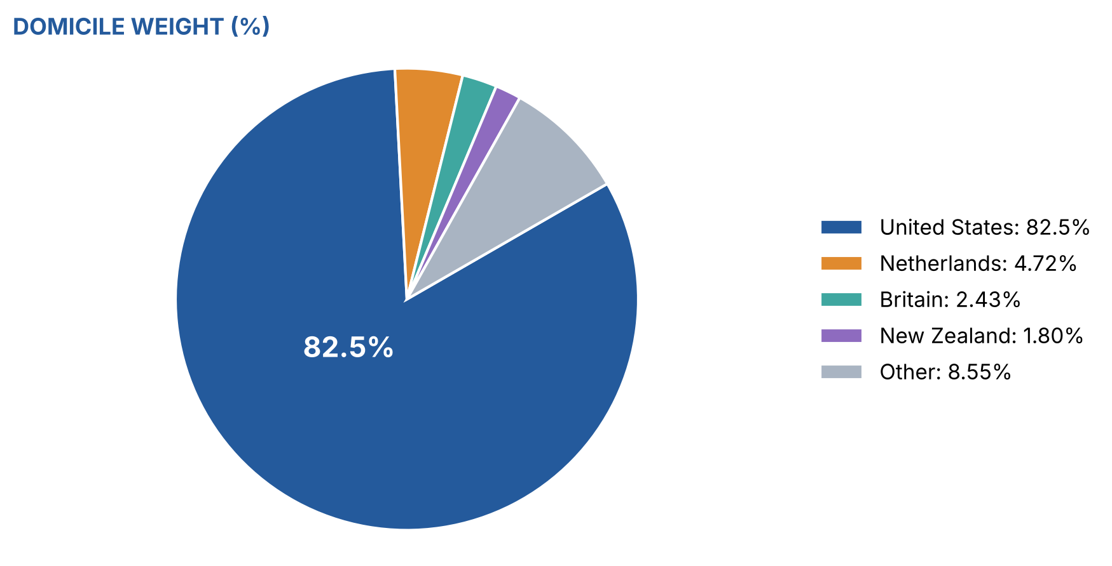
FINX | GEOGRAPHIC AND SECTOR EXPOSURE
A global mandate remains
predominantly U.S. exposure
Issuer equity exposure snapshot: August 31, 2026
53.65%
Financial services
43.73%
Software & services
Sources: Global X FINX fact sheet, August 31, 2026; assets.globalxetfs.com/funds/documents/finx/Fact-Sheet_FINX.pdf.
08
Notes:
Geographic and industry breakdowns exclude cash, currencies and other holdings. Non-U.S. weight is calculated as 100 minus 82.49 = 17.51%. Domicile is not revenue exposure and does not capture all FX or international-demand risk. Industry categories are not directly comparable with ARK technology themes or Fidelity sub-industries.
SOURCES (accessed September 30, 2026 unless a supplied document):
https://assets.globalxetfs.com/funds/documents/finx/Fact-Sheet_FINX.pdf
Figures are historical unless explicitly identified as analyst judgment. Holdings can change. Past performance does not predict future returns.

Slide 29
FINX | HOLDINGS AND PERFORMANCE DRIVERS
Index discipline still leaves
substantial company concentration
Holdings as of September 29, 2026 | Key Drivers per Analyst Assessment
Largest holdings | Weight | Primary sensitivity¹
Robinhood | 8.73% | Trading activity and net deposits
PayPal | 6.84% | Payment growth and margins
Block | 6.64% | Merchant and Cash App economics
Coinbase | 5.59% | Crypto activity and regulation
Fiserv | 4.29% | Processing and merchant execution
51.43%
1-year NAV: −27.04% vs index −26.75%
Through June 30, 2026; gap: −0.29 pp.
Theme selection matters more than tracking alone.
Top 10 weight²
Sources: Global X FINX holdings and performance: globalxetfs.com/funds/finx/; ¹analyst judgment; ²sum of disclosed top 10.
09
Notes:
Top 10 concentration is calculated from issuer weights on September 29, 2026. Other top 10 holdings: Global Payments 4.28%, Adyen 4.15%, SoFi 3.72%, Affirm 3.72%, Intuit 3.47%. The 29 bp one-year NAV/index gap is a historical outcome, not a forecast of tracking error. The index is before fund expenses. Constituents can drift between rebalances; caps do not guarantee daily maximum weights.
SOURCES (accessed September 30, 2026 unless a supplied document):
https://www.globalxetfs.com/funds/finx/
https://globalxetfs.com.br/content/files/summary-prospectus-FINX-2026.pdf
Figures are historical unless explicitly identified as analyst judgment. Holdings can change. Past performance does not predict future returns.

Slide 30
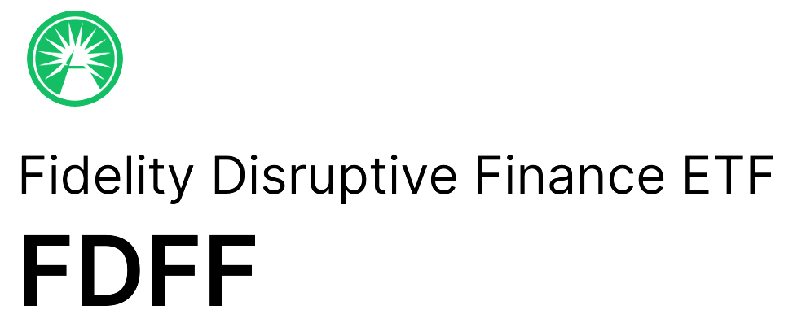
FDFF | MANDATE AND MANAGEMENT
Active exposure to financial innovation
80%+
Global opportunity set
Normally invested in
disruptive finance companies
Approach
Fundamental stock selection
Quantitative portfolio construction
Michael Kim: quantitative analyst
and portfolio manager
Matt Reed: co-management on
November 18, 2025
46
0.50%
holdings
expense ratio
Sources:
[1] https://institutional.fidelity.com/app/proxy/content?literatureURL=/9910078.PDF
[2] https://digital.fidelity.com/prgw/digital/research/quote/dashboard/summary?symbol=FDFF

Slide 31
FDFF | PORTFOLIO COMPOSITION
Financial incumbents anchor the portfolio
Largest five holdings
Industry mix
48%
Banks and capital markets add
different earnings drivers and risks.
in the top 10 holdings
Sources: https://institutional.fidelity.com/app/proxy/content?literatureURL=/9910078.PDF
11

Slide 32
FDFF | PERFORMANCE AND RESPONSE
Payment stocks drove the performance shortfall
Total return
Selected relative contributions
Basis points vs. the financials index¹
Note: Financials index means MSCI ACWI Financials Equal Weighted Index.
Source: https://www.msci.com/indexes/index/106751/msci-acwi-financials-index

Slide 33
CONCLUSION | HOLDINGS
Three ETFs, three different FinTech bets
# | ARKF Bitcoin & commerce | FINX Payments & brokerage | FDFF Banks & asset managers
1 | Shopify 9.9% | Robinhood 8.56% | DBS Group 6.00%
2 | Robinhood 6.4% | PayPal 6.74% | Capital One 5.82%
3 | Block 6.2% | Block 6.67% | BlackRock 5.54%
4 | ARK 21Shares BTC 5.8% | Coinbase 5.55% | Bankinter 4.88%
5 | Coinbase 5.3% | Fiserv 4.33% | FinecoBank 4.66%
6 | Toast 4.6% | Global Payments 4.25% | Visa 4.57%
7 | AMD 4.4% | Adyen 4.24% | Mastercard 4.35%
8 | Circle 4.2% | Affirm 3.76% | Block 4.21%
9 | Palantir 4.2% | SoFi 3.72% | Apollo 4.13%
10 | Amazon 4.0% | Intuit 3.61% | Hiscox 3.95%
Top 10 | 55.0% | 51.43% | 48.10%
Sources: ARK ARKF fact sheet (6/30/26); Global X FINX holdings (9/30/26); Fidelity FDFF fact sheet (6/30/26)
Notes:
Holdings use the issuer snapshots already cited in the committee presentation. The dates differ, so this is not a synchronized latest-day overlap comparison.
SOURCES
ARKF: User-supplied ARKF Fact Sheet (1).pdf, June 30, 2026, page 1. https://www.ark-funds.com/funds/arkf/
FINX: Issuer holdings as of September 29, 2026, retrieved October 1, 2026 UTC. https://www.globalxetfs.com/funds/finx/
FDFF: Fidelity Disruptive Finance ETF fact sheet, June 30, 2026, page 2. https://institutional.fidelity.com/app/proxy/content?literatureURL=/9910078.PDF
CALCULATION
ARKF displayed top 10 sum to 55.0%; calculated other holdings 45.0%. FINX displayed top 10 sum to 51.43%; other holdings 48.57%. FDFF displayed top 10 sum to 48.11%; calculated other holdings 51.89%. Fidelity reports an aggregate top-10 figure of 48.10%, which differs by 0.01 percentage points from the sum of individually rounded weights. The table calculates its residual from the displayed entries so each column sums to 100%. Residuals include cash and net other assets where applicable.
ABBREVIATIONS
ARK 21Shares BTC = ARK 21Shares Bitcoin ETF, a fund rather than an operating company. AMD = Advanced Micro Devices. Circle = Circle Internet Group. Palantir = Palantir Technologies. Apollo Global = Apollo Global Management. Other company names omit legal suffixes or share classes for readability.
INTERPRETATION
ARKF and FINX share Robinhood, Block and Coinbase among their largest exposures. FDFF's largest positions include banks and asset managers, while Block appears in all three top-10 lists at their respective dates.
Design reference: user-supplied image(1).png. Editable 4:3 table with ten ranked holdings and an Other holdings row.

Slide 34
CONCLUSION | HOLDINGS OVERLAP
Block is the only name all three ETFs share
ARKF: only fund with bitcoin
FINX: payment processors
FDFF: banks and asset managers
FDFF shares only Block
Sources: ARK ARKF fact sheet (6/30/26); Global X FINX holdings (9/30/26); Fidelity FDFF fact sheet (6/30/26)
Notes:
WHAT THIS SLIDE SAYS
Overlap: five names appear in more than one fund's top 10. Block is the only name held in all three. Robinhood, Coinbase, Circle and Toast are shared by ARKF and FINX only; FDFF's top 10 contains none of them, which is why FDFF behaves differently.
Unique to each fund: ARKF holds the ARK 21Shares Bitcoin ETF (direct bitcoin exposure), Shopify, AMD, Palantir, Amazon. FINX holds payment processors PayPal, Fiserv, Global Payments, Adyen. FDFF holds banks (DBS, Capital One, Bankinter, FinecoBank), asset managers (BlackRock, Apollo), Visa, Mastercard, Hiscox.
SOURCES
ARKF top 10: ARK fact sheet, Jun 30, 2026. FINX: Global X full holdings file, Sep 30, 2026. FDFF top 10: Fidelity fact sheet, Jun 30, 2026. A zero bar means the name is not in that fund's disclosed top 10; it may still be held below the top 10.

Slide 35
CONCLUSION | COMPARISON
FDFF is cheapest; ARKF trades most and is most volatile
Sources: Issuer fact sheets; Finviz (9/30/26); Portfolio Visualizer (Jan 2024–Sep 2026); correlation from Digrin monthly prices
Notes:
WHAT THIS SLIDE SAYS
Expense ratio and trading volume are the two most important comparison metrics. FDFF is the cheapest (0.50%); ARKF trades the most (128,310 shares a day). Volatility: ARKF, with bitcoin exposure, is the most volatile (34.81%). Correlation to SPY: FDFF is the least correlated (0.64).
SOURCES
Expense ratios: ARK fact sheet (6/30/26) 0.75%; Global X FINX page (9/30/26) 0.68%; Fidelity FDFF fact sheet (6/30/26) 0.50%.
Average daily volume: Finviz recent 3-month average, retrieved Sep 30, 2026.
Volatility: Portfolio Visualizer, Jan 2024 – Sep 2026, monthly returns (group slide 9).
Correlation to SPY: analyst calculation, CORREL of monthly returns from Digrin month-end adjusted prices, Jan 2024 – Sep 2026 (33 months). Same data gives SDs within ~0.8 pp of Portfolio Visualizer. Confirm in Portfolio Visualizer's asset-correlation table.

Slide 36
CONCLUSION | COMPARISON DETAIL
FDFF: lowest cost, volatility and correlation; highest dividend
Metric | ARKF | FINX | FDFF
Expense ratio | 0.75% | 0.68% | 0.50%
Avg daily volume | 128,310 | 63,530 | 4,250
Volatility | 34.81% | 24.36% | 18.59%
Correlation to SPY | 0.68 | 0.75 | 0.64
Dividend yield | c.0.1% | c.0.8% | c.0.9%
Management | Active | Passive | Active
AUM | $838.7M | $155.0M | $43.0M
Sources: Issuer fact sheets; Finviz (9/30/26); Portfolio Visualizer; Digrin; dividend yields: Digrin, Trackinsight (trailing 12 months)
Notes:
WHAT THIS SLIDE SAYS
Detailed comparison, in the same table format as the holdings slide, including dividend yield.
NOTES
Expense ratio and volume: as previous slide. AUM: Finviz (ARKF, FDFF) and Global X (FINX), Sep 30, 2026; shown last because it matters less than cost and trading volume.
Dividend yield: trailing 12 months, third-party estimates (approximate): ARKF ~0.1% (Digrin, one $0.043 distribution in Dec 2025); FINX ~0.8% (Trackinsight 0.83%, Dividend.watch 0.80%); FDFF ~0.9% (Digrin 0.92%; Snowball 0.91%). FDFF pays the highest dividend of the three. Confirm on issuer pages before publishing.
DETAILED SOURCES
1. Expense ratio, volume, volatility, correlation: as previous slide.
2. AUM, Sep 30, 2026: ARKF $838.65M and FDFF $43.01M (Finviz) https://finviz.com/stock?t=ARKF ; https://finviz.com/stock?t=FDFF ; FINX $155.02M (Global X) https://www.globalxetfs.com/funds/finx/
3. Dividend yield, trailing 12 months (third-party, approximate): ARKF ~0.1% (Digrin) https://www.digrin.com/stocks/detail/ARKF/ ; FINX ~0.8% (Trackinsight 0.83%) https://www.trackinsight.com/en/fund/XNMS:FINX/distribution ; FDFF ~0.9% (Digrin 0.92%; Snowball 0.91%) https://www.digrin.com/stocks/detail/FDFF/ ; https://snowball-analytics.com/public/asset/FDFF.NASDAQ
Confirm yields on issuer pages before publishing.

Slide 37
CONCLUSION | WHAT TO WATCH
What to watch for the FinTech industry
Interest rates
Regulation
Fed at 3.75–4.00% after the Sep 16 hike; higher rates raise funding costs
GENIUS stablecoin licensing from Jan 18, 2027; open-banking rules
Payment volumes
Consumer credit
Visa payments volume +10% y/y; watch Q3 guidance
Credit losses at lenders and BNPL providers
Sources: Federal Reserve (9/16/26); U.S. Treasury (GENIUS); CFPB; Visa FYQ3 2026.
Notes:
WHAT THIS SLIDE SAYS
Industry-level indicators to monitor over the next year.
SOURCES
Rates: Federal Reserve FOMC statement, Sep 16, 2026 — target range 3.75–4.00% after a 25 bp increase (as cited on deck slide 12). Higher rates support bank net interest income (FDFF) but pressure high-multiple growth (ARKF) and lenders' funding (Affirm, SoFi in FINX).
Stablecoin rules: GENIUS licensing requirements expected from Jan 18, 2027 per U.S. Treasury, as cited on deck slide 11 (verify against the Treasury release). Most relevant to Circle and Coinbase (ARKF, FINX).
Payments: Visa FYQ3 2026 (quarter to Jun 30) payments volume +10% y/y in constant dollars (deck slide 10). Payments are FINX's largest exposure.
Consumer credit: weak borrowers and higher losses can hurt lenders and BNPL providers (group slide 12).
These are monitoring items, not forecasts.
DETAILED SOURCES
1. Federal Reserve, FOMC statement, September 16, 2026: target range 3.75–4.00% after a 25 bp increase. https://www.federalreserve.gov/newsevents/pressreleases/monetary20260916a.htm
2. U.S. Treasury, GENIUS Act rulemaking: licensing requirements expected from January 18, 2027 (as cited on the group regulation slide; verify against the Treasury release).
3. CFPB, personal financial data rights (open banking) rulemaking (as cited on the group regulation slide).
4. Visa, FYQ3 2026 earnings release (quarter ended June 30, 2026): payments volume +10% y/y, constant dollars. https://investor.visa.com
5. Consumer credit risk for lenders and BNPL providers: group catalysts slide.

Slide 38
CONCLUSION | BULL AND BEAR DRIVERS
What would push each ETF to bull or bear
ETF | Bull driver | Bear driver
ARKF | Bitcoin rally; clear stablecoin rules | Crypto sell-off; growth de-rating
FINX | Payment volumes and trading activity hold | Payment fee pressure; consumer credit losses
FDFF | Higher-for-longer rates lift bank income | Credit cycle turns; rate cuts squeeze banks
Sources: Issuer fact sheets: ARK ARKF (6/30/26), Global X FINX (9/30/26), Fidelity FDFF (6/30/26).
Notes:
WHAT THIS SLIDE SAYS
For each fund, what would push it toward a bull or bear outcome over the next 12 months. These are scenario drivers, not forecasts or probabilities.
LINK TO HOLDINGS
ARKF: ARK 21Shares Bitcoin ETF 5.8%, Coinbase 5.3%, Circle 4.2% (crypto); Shopify 9.9%, Amazon 4.0% (commerce). High volatility (34.81%) means both outcomes are wide.
FINX: Robinhood 8.56%, PayPal 6.74%, Block 6.67%, Fiserv 4.33%, Global Payments 4.25% (payments and brokerage); Affirm and SoFi (consumer credit).
FDFF: DBS, Capital One, Bankinter, FinecoBank (banks); BlackRock, Apollo (asset managers). Bank income is rate-sensitive; Capital One is exposed to card credit losses.
DETAILED SOURCES
1. ARK, ARKF fact sheet, June 30, 2026 (ARK 21Shares Bitcoin ETF 5.8%, Coinbase 5.3%, Circle 4.2%, Shopify 9.9%). https://www.ark-funds.com/funds/arkf/
2. Global X, FINX holdings, September 30, 2026 (Robinhood, PayPal, Block, Fiserv, Global Payments; Affirm, SoFi). https://www.globalxetfs.com/funds/finx/
3. Fidelity, FDFF fact sheet, June 30, 2026 (DBS, Capital One, Bankinter, FinecoBank; BlackRock, Apollo). https://institutional.fidelity.com/app/proxy/content?literatureURL=/9910078.PDF
Bull and bear drivers are scenarios, not forecasts or probabilities.

Slide 39
CONCLUSION | PORTFOLIO SOLUTION
FinTech: 10% of equity for diversification, FDFF majority, ARKF least
Weight | ETF | Why
60% | FDFF | Financial institutions, low volatility, high dividend
30% | FINX | Payments exposure
10% | ARKF | Most risky: least exposure
10%
0.72
c.0.8%
21.5%
of total equity
correlation to SPY: diversifies
sleeve dividend yield
sleeve volatility vs ARKF 34.8%
Sources: Portfolio Visualizer (Jan 2024–Sep 2026); Digrin monthly prices; dividend yields: Digrin, Trackinsight (trailing 12 months).
Notes:
CONCLUSION
FinTech is only 10% of the total equity position and serves a diversification purpose: the sleeve's correlation to SPY is 0.72 (below 1.0), and FDFF's is the lowest (0.64).
FDFF is the majority (60%) because it holds financial institutions, has the lowest volatility (18.59%) and the highest dividend yield (~0.9%).
FINX (30%) provides the payments exposure.
ARKF, the most risky fund (volatility 34.81%, bitcoin exposure), has the least exposure (10%).
CALCULATIONS
Sleeve dividend yield = 0.6×0.92% + 0.3×0.80% + 0.1×0.10% = 0.80% (approximate, third-party yields).
Sleeve correlation and volatility (21.46%): monthly returns, Digrin prices, Jan 2024 – Sep 2026.
DETAILED SOURCES
1. Volatility: Portfolio Visualizer, Jan 2024 – Sep 2026, monthly (FDFF 18.59%, FINX 24.36%, ARKF 34.81%). https://www.portfoliovisualizer.com/backtest-portfolio
2. Correlation to SPY and sleeve volatility: calculated from Digrin monthly prices, Jan 2024 – Sep 2026 (sleeve correlation 0.72; sleeve volatility 21.46%). https://www.digrin.com/stocks/detail/SPY/price
3. Dividend yields (TTM, approximate): Digrin, Trackinsight, Snowball (see comparison slide). Sleeve yield = 0.6×0.92% + 0.3×0.80% + 0.1×0.10% = 0.80%.
4. Allocation: 10% of total equity; 60% FDFF / 30% FINX / 10% ARKF — group recommendation. Workbook: Theo_Conclusion_Support_v4.xlsx.

Slide 40
AI References:
[1] https://chatgpt.com/share/6abde06d-be30-83ea-9bd9-0de8be05529c
[2] https://chatgpt.com/share/6abde4a6-b754-83ea-a34a-facc5ca2dbcb
[3] https://chatgpt.com/share/6abe70d1-d01c-83ea-8862-8ef30963e771
[4] Perplexity Finance Primary Source Information: https://www.perplexity.ai/search/7f3c8996-67ec-48df-b13b-d583821f0b4b

